Slide 1


What House Shall We Buy?
Team Pikachu

Slide 2
Business Strategy
Look through airbnb websites and analyse popular accommodations
Look for pattern associated with popular accommodations
Search available properties in the market
Pick a suitable type of housing that is potentially the most profitable based on various metrics

Slide 3
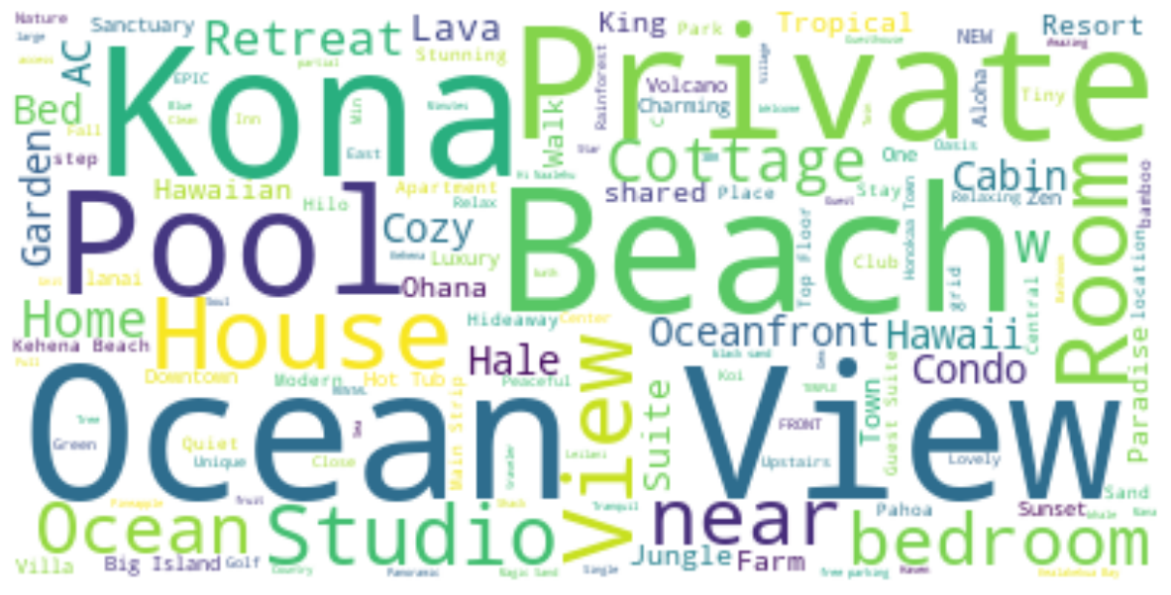
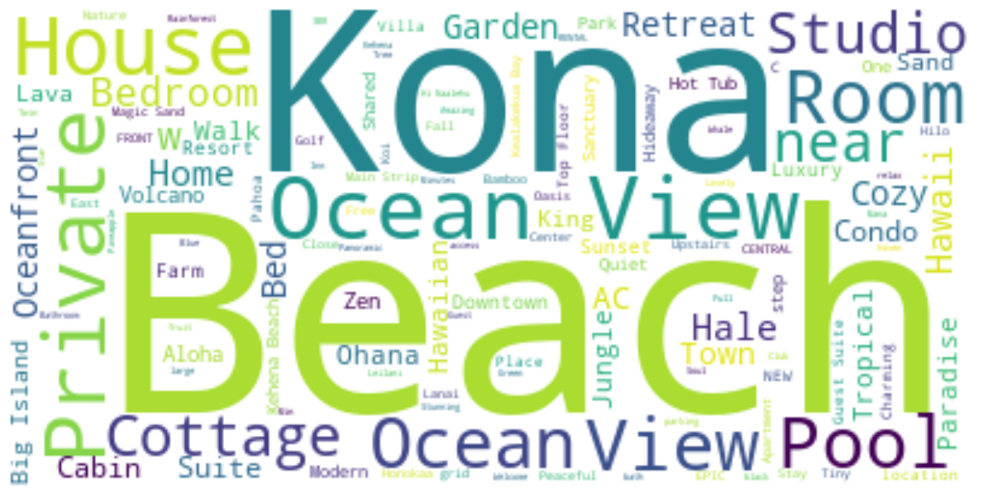
Desirable Phrases within descriptions
Reviewing all words written in descriptions of Airbnb, these are the more common phrases used: Ocean, Beach, View, Private, Pool, Kona, etc…
Focusing on descriptions that has ratings of 4.5 and over, phrases which gained the most tractions were: Kona, Beach, Ocean, House, View, Pool, etc…
Notes:
As seen, private housing near the beach or the ocean with a great view is the most popular. Additional amenities like a pool or near a volcano can even be a big plus.

Slide 4
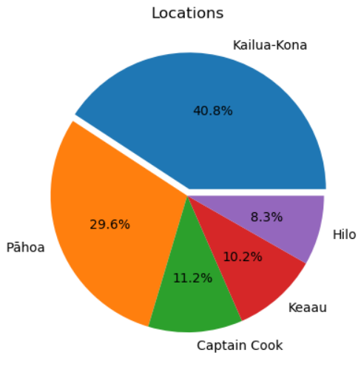
Popular Locations

Slide 5
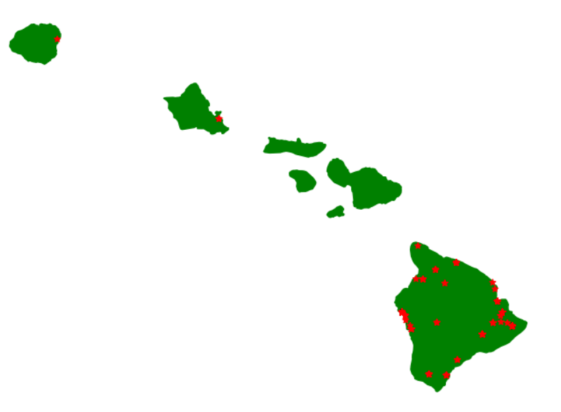
Popular Locations
Hilo
Keaau
Pāhoa
Kailua-Kona
Captain Cook

Slide 6
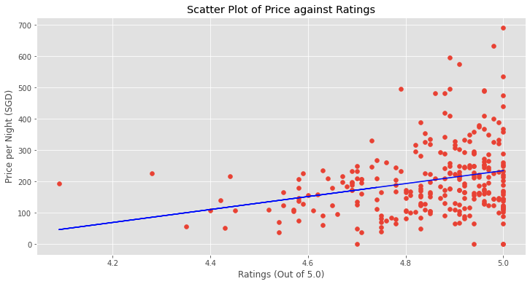
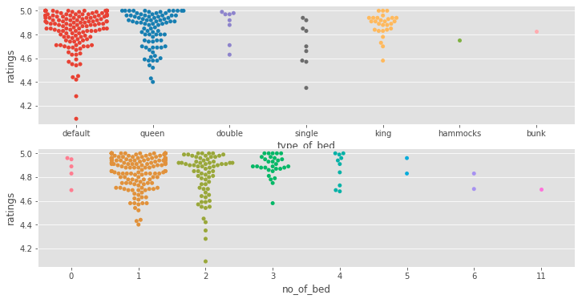
Distributions of Type & No. of beds
Price vs Ratings
Notes:
In general, higher ratings would result in a higher price point. But there may be a negative effect of setting the prices to high in popular locations as the spread of the price for high ratings is quite large.
At the same time we can see that the general trend fo accommodations offers about 1 or 2 beds with a large preference for default/queen beds. We can possibly infer that people who visit hawaii are there on a budget and the number of beds suggests that they travel in small groups (possibly couples since its good as a honeymoon location)

Slide 7
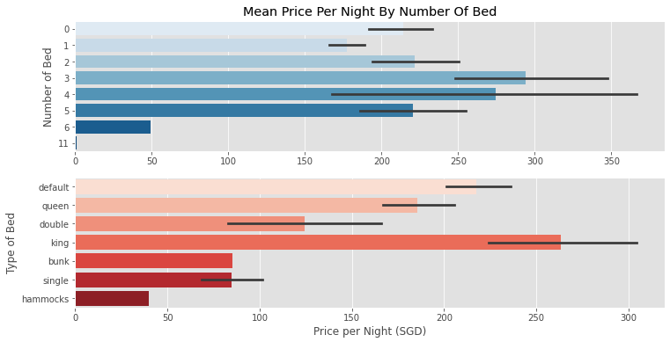
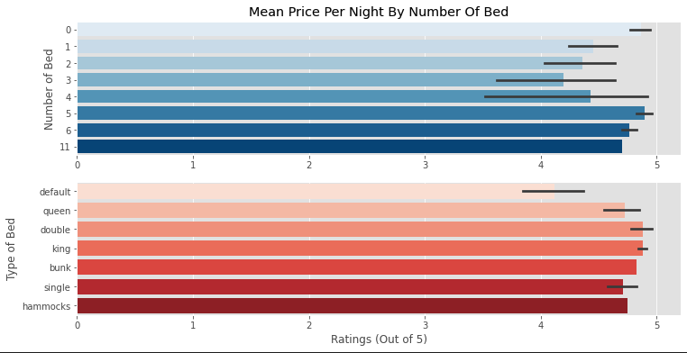
Type & Number of Beds against Price and Ratings
Notes:
Th graph on the right shows that the type and the number of beds does not really affect the Price and the ratings of the accommodation (but rather could be attributed more towards the specific amenities that the accommodations have)
The one on the left would show firstly that 3 beds would offer the highest price per night but other number does not fall far apart (if we are more interested in cost per person we could possibly cater more towards 1 or 2 beds

Slide 8
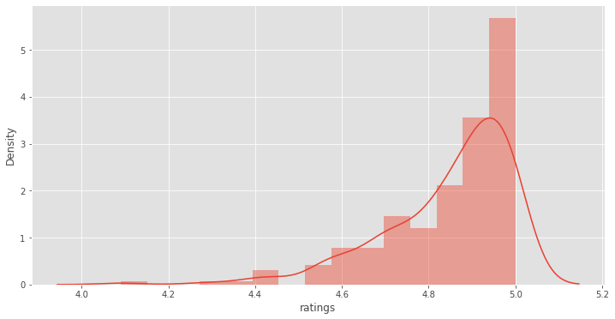
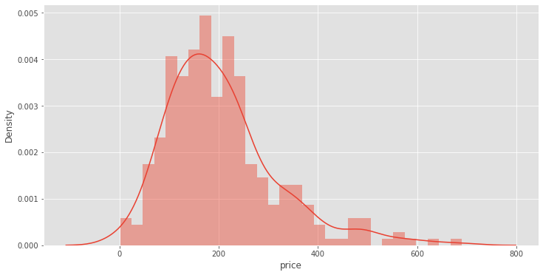
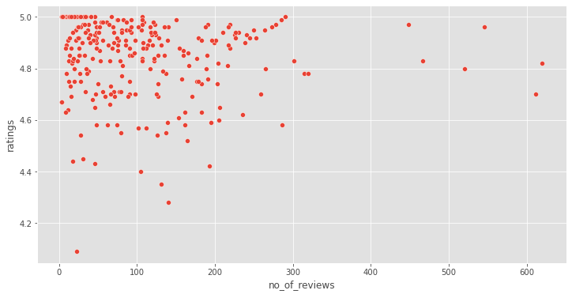
Price Distributions Rating Distribution
Notes:
Although high avg ratings, majority have too few reviews to be reliable

Slide 9
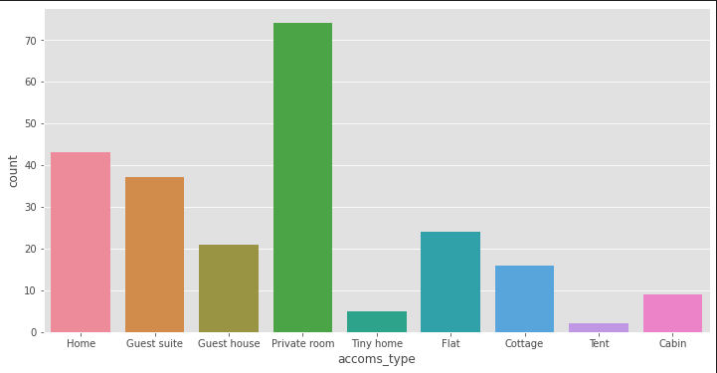
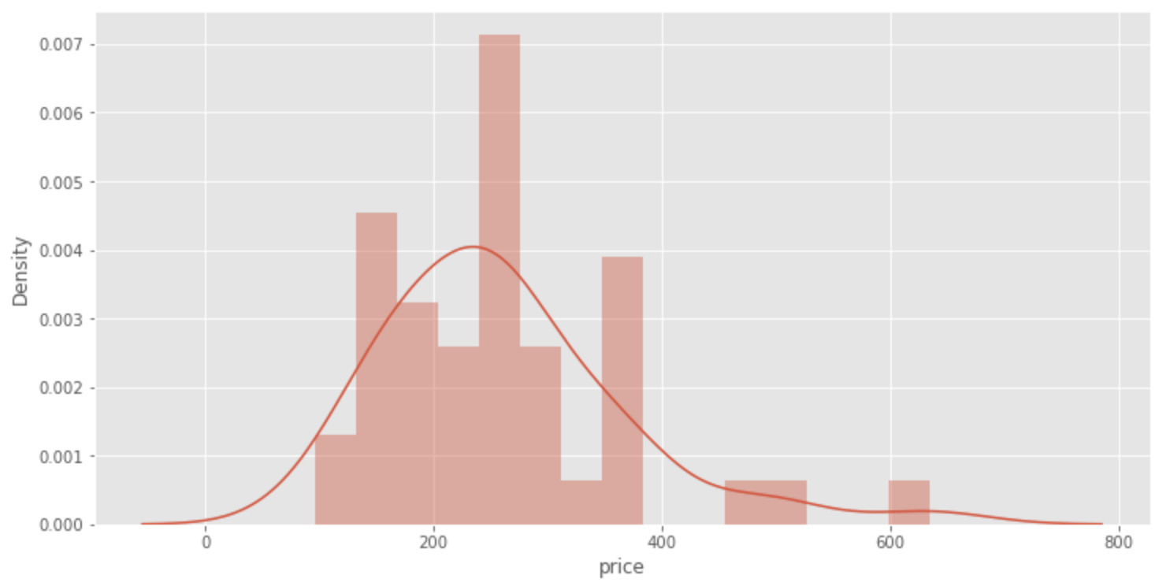
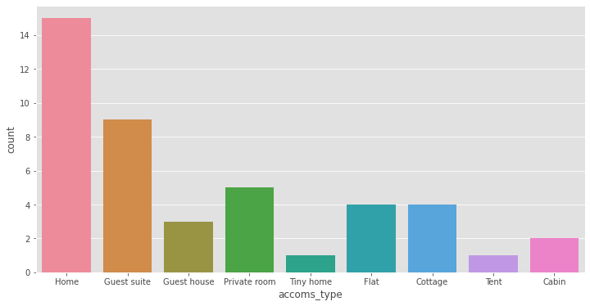
In a Subgroup of high ratings and high reviews

Slide 10
Conclusion
Popular locations: near Kailua-Kona or Pāhoa
Good ocean views, near the beach with amenities
e.g. pools
Accommodation Type: House
Priced affordably ($200 - $300)
Notes:
Accommodation type: house, that can house 2-4 people will be ideal

